Slide 1

Chapter 8: Project Quality Management
Information Technology Project Management, Seventh Edition
Note: See the text itself for full citations.

Slide 2
Learning Objectives
Understand the importance of project quality management for information technology (IT) products and services
Define project quality management and understand how quality relates to various aspects of IT projects
Describe quality management planning and how quality and scope management are related
Discuss the importance of quality assurance
Explain the main outputs of the quality control process

Slide 3
Learning Objectives
Understand the tools and techniques for quality control, such as the Seven Basic Tools of Quality, statistical sampling, Six Sigma, and testing
Summarize the contributions of noteworthy quality experts to modern quality management
Describe how leadership, the cost of quality, organizational influences, expectations, cultural differences, and maturity models relate to improving quality in IT projects
Discuss how software can assist in project quality management

Slide 4
The Importance of Project Quality Management
Many people joke about the poor quality of IT products (see cars and computers joke on pages 312-313)
People seem to accept systems being down occasionally or needing to reboot their PCs
But quality is very important in many IT projects

Slide 5
What Is Project Quality?
The International Organization for Standardization (ISO) defines quality as “the degree to which a set of inherent characteristics fulfils requirements” (ISO9000:2000)
Other experts define quality based on:
Conformance to requirements: The project’s processes and products meet written specifications
Fitness for use: A product can be used as it was intended

Slide 6
What Is Project Quality Management?
Project quality management ensures that the project will satisfy the needs for which it was undertaken
Processes include:
Planning quality management: Identifying which quality standards are relevant to the project and how to satisfy them; a metric is a standard of measurement
Performing quality assurance: Periodically evaluating overall project performance to ensure the project will satisfy the relevant quality standards
Performing quality control: Monitoring specific project results to ensure that they comply with the relevant quality standards

Slide 7
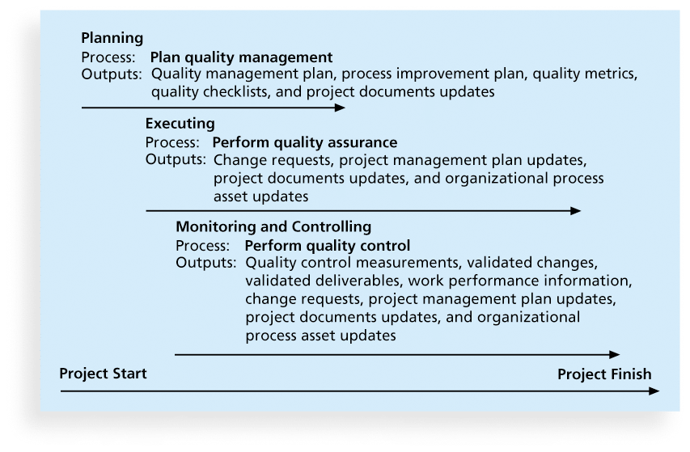
Figure 8-1. Project Quality Management Summary

Slide 8
Planning Quality
Implies the ability to anticipate situations and prepare actions to bring about the desired outcome
Important to prevent defects by:
Selecting proper materials
Training and indoctrinating people in quality
Planning a process that ensures the appropriate outcome

Slide 9
Scope Aspects of IT Projects
Functionality is the degree to which a system performs its intended function
Features are the system’s special characteristics that appeal to users
System outputs are the screens and reports the system generates
Performance addresses how well a product or service performs the customer’s intended use
Reliability is the ability of a product or service to perform as expected under normal conditions
Maintainability addresses the ease of performing maintenance on a product

Slide 10
Who’s Responsible for the Quality of Projects?
Project managers are ultimately responsible for quality management on their projects
Several organizations and references can help project managers and their teams understand quality
International Organization for Standardization (www.iso.org)
IEEE (www.ieee.org)

Slide 11
Performing Quality Assurance
Quality assurance includes all the activities related to satisfying the relevant quality standards for a project
Another goal of quality assurance is continuous quality improvement
Benchmarking generates ideas for quality improvements by comparing specific project practices or product characteristics to those of other projects or products within or outside the performing organization
A quality audit is a structured review of specific quality management activities that help identify lessons learned that could improve performance on current or future projects

Slide 12
Controlling Quality
There are Seven Basic Tools of Quality that help in performing quality control:
Cause-and-Effect Diagrams
Quality Control Charts
The Seven Run Rule
Checksheet
Scatter diagram
Histograms
Pareto Charts

Slide 13
1. Cause-and-Effect Diagrams
Cause-and-effect diagrams trace complaints about quality problems back to the responsible production operations
They help you find the root cause of a problem
Also known as fishbone or Ishikawa diagrams
Can also use the 5 whys technique where you repeated ask the question “Why” (five is a good rule of thumb) to peel away the layers of symptoms that can lead to the root cause

Slide 14
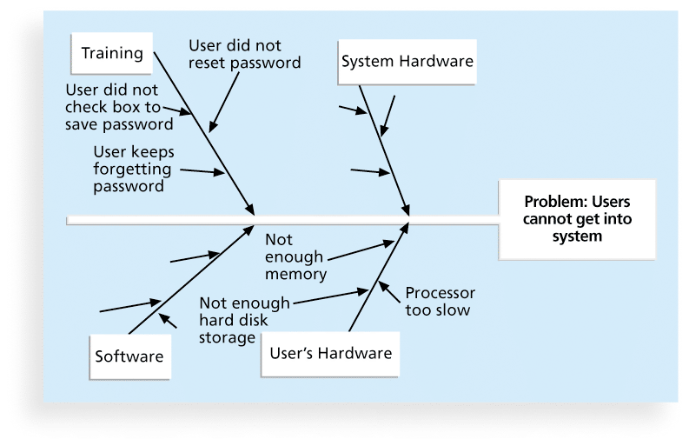
Figure 8-2. Sample Cause-and-Effect Diagram

Slide 15
2. Quality Control Charts
A control chart is a graphic display of data that illustrates the results of a process over time
The main use of control charts is to prevent defects, rather than to detect or reject them
Quality control charts allow you to determine whether a process is in control or out of control
When a process is in control, any variations in the results of the process are created by random events; processes that are in control do not need to be adjusted
When a process is out of control, variations in the results of the process are caused by non-random events; you need to identify the causes of those non-random events and adjust the process to correct or eliminate them

Slide 16
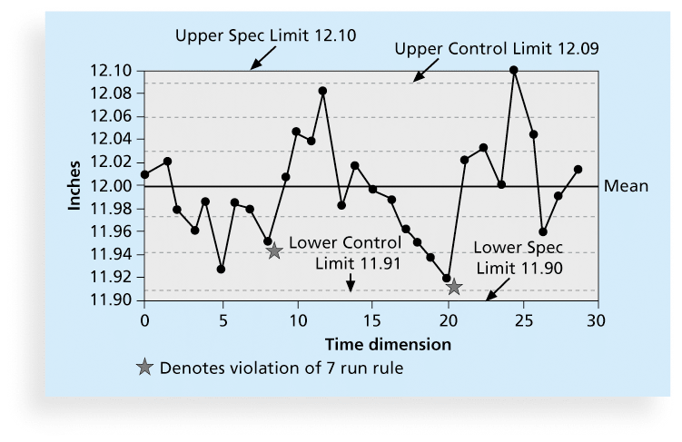
Figure 8-3. Sample Quality Control Chart

Slide 17
3. The Seven Run Rule
You can use quality control charts and the seven run rule to look for patterns in data
The seven run rule states that if seven data points in a row are all below the mean, above the mean, or are all increasing or decreasing, then the process needs to be examined for non-random problems

Slide 18
4. Checksheet
A checksheet is used to collect and analyze data
It is sometimes called a tally sheet or checklist, depending on its format
In the example in Figure 8-4, most complaints arrive via text message, and there are more complaints on Monday and Tuesday than on other days of the week
This information might be useful in improving the process for handling complaints

Slide 19
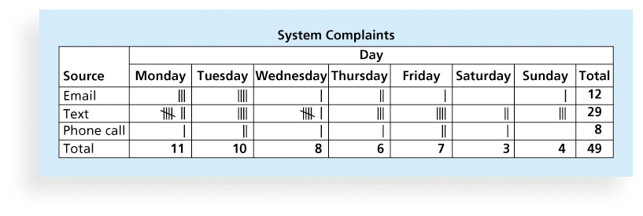
Figure 8-4. Sample Checksheet

Slide 20
5. Scatter diagram
A scatter diagram helps to show if there is a relationship between two variables
The closer data points are to a diagonal line, the more closely the two variables are related

Slide 21
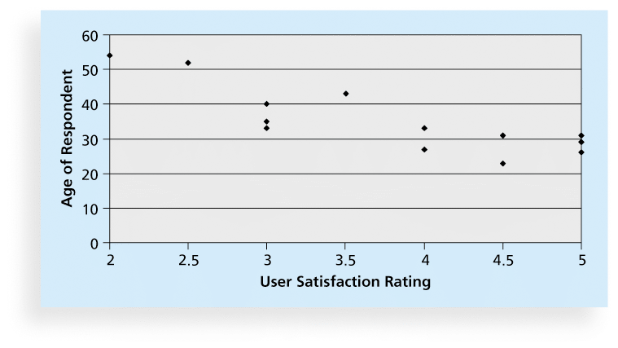
Figure 8-5. Sample Scatter Diagram

Slide 22
6. Histograms
A histogram is a bar graph of a distribution of variables
Each bar represents an attribute or characteristic of a problem or situation, and the height of the bar represents its frequency

Slide 23
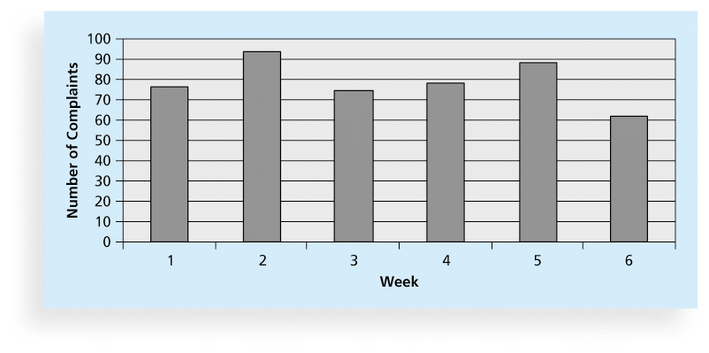
Figure 8-6. Sample Histogram

Slide 24
7. Pareto Charts
A Pareto chart is a histogram that can help you identify and prioritize problem areas
Pareto analysis is also called the 80-20 rule, meaning that 80 percent of problems are often due to 20 percent of the causes

Slide 25
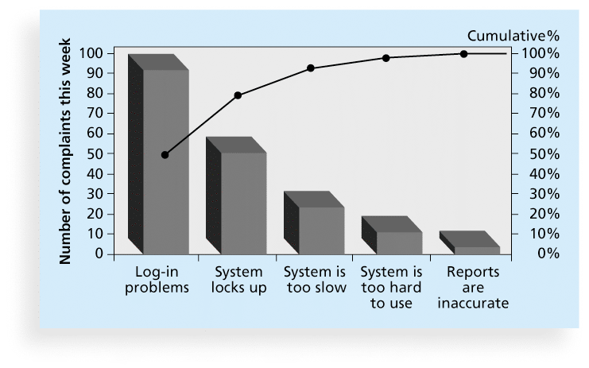
Figure 8-7. Sample Pareto Chart

Slide 26
7. Flowcharts
Flowcharts are graphic displays of the logic and flow of processes that help you analyze how problems occur and how processes can be improved
They show activities, decision points, and the order of how information is processed

Slide 27
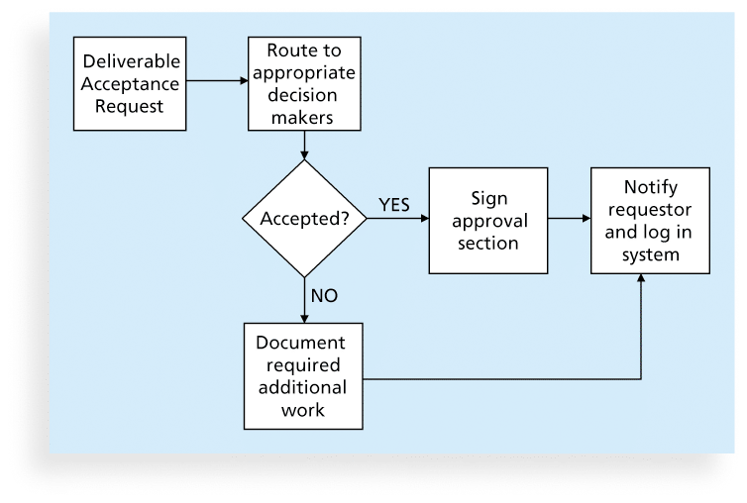
Figure 8-8. Sample Flowchart

Slide 28
Run Charts
In addition to flowcharts, run charts are also used for stratification, a technique that shows data from a variety of sources to see if a pattern emerges
A run chart displays the history and pattern of variation of a process over time.
You can use run charts to perform trend analysis and forecast future outcomes based on historical results

Slide 29
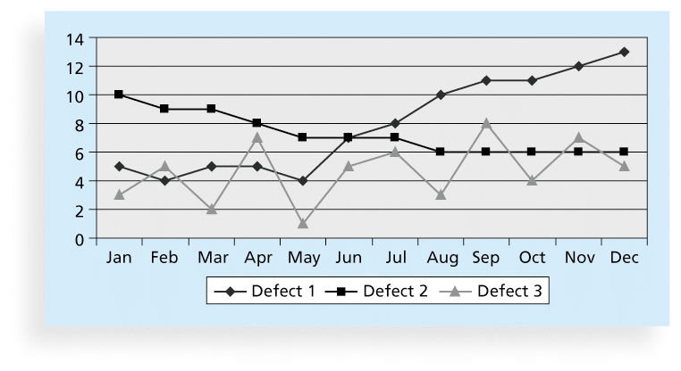
Figure 8-9. Sample Run Chart

Slide 30
Six Sigma
Six Sigma is “a comprehensive and flexible system for achieving, sustaining, and maximizing business success. Six Sigma is uniquely driven by close understanding of customer needs, disciplined use of facts, data, and statistical analysis, and diligent attention to managing, improving, and reinventing business processes”*
*Pande, Peter S., Robert P. Neuman, and Roland R. Cavanagh, The
Six Sigma Way, New York: McGraw-Hill, 2000, p. xi.

Slide 31
Basic Information on Six Sigma
The target for perfection is the achievement of no more than 3.4 defects per million opportunities
The principles can apply to a wide variety of processes
Six Sigma projects normally follow a five-phase improvement process called DMAIC

Slide 32
DMAIC
DMAIC is a systematic, closed-loop process for continued improvement that is scientific and fact based
DMAIC stands for:
Define: Define the problem/opportunity, process, and customer requirements
Measure: Define measures, then collect, compile, and display data
Analyze: Scrutinize process details to find improvement opportunities
Improve: Generate solutions and ideas for improving the problem
Control: Track and verify the stability of the improvements and the predictability of the solution

Slide 33
How is Six Sigma Quality Control Unique?
It requires an organization-wide commitment.
Training follows the “Belt” system
Six Sigma organizations have the ability and willingness to adopt contrary objectives, such as reducing errors and getting things done faster
It is an operating philosophy that is customer focused and strives to drive out waste, raise levels of quality, and improve financial performance at breakthrough levels

Slide 34
Six Sigma Projects Use Project Management
The training for Six Sigma includes many project management concepts, tools, and techniques
For example, Six Sigma projects often use business cases, project charters, schedules, budgets, and so on
Six Sigma projects are done in teams; the project manager is often called the team leader, and the sponsor is called the champion

Slide 35
Six Sigma and Statistics
The term sigma means standard deviation
Standard deviation measures how much variation exists in a distribution of data
Standard deviation is a key factor in determining the acceptable number of defective units found in a population
Six Sigma projects strive for no more than 3.4 defects per million opportunities, yet this number is confusing to many statisticians

Slide 36
Six Sigma Uses a Conversion Table
Using a normal curve, if a process is at six sigma, there would be no more than two defective units per billion produced
Six Sigma uses a scoring system that accounts for time, an important factor in determining process variations
Yield represents the number of units handled correctly through the process steps
A defect is any instance where the product or service fails to meet customer requirements
There can be several opportunities to have a defect

Slide 37
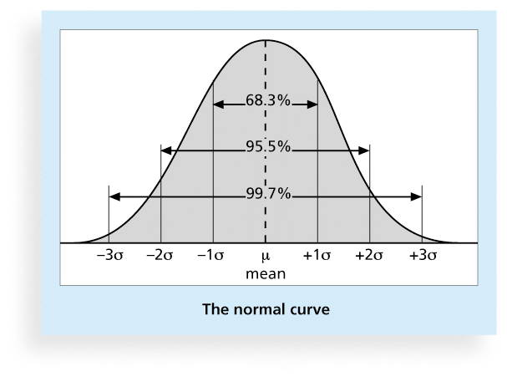
Figure 8-10. Normal Distribution and Standard Deviation

Slide 38
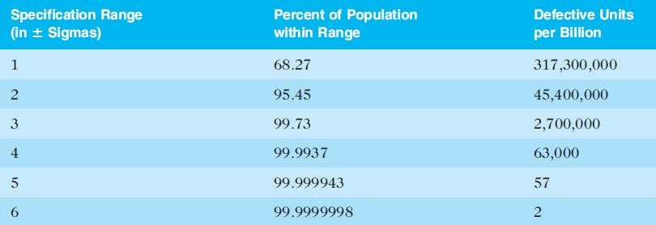
Table 8-2. Sigma and Defective Units

Slide 39
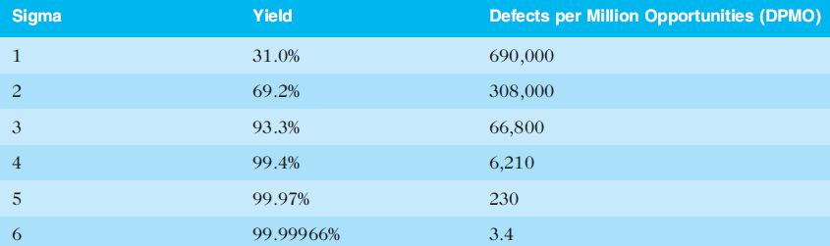
Table 8-3: Sigma Conversion Table

Slide 40
Six 9s of Quality
Six 9s of quality is a measure of quality control equal to 1 fault in 1 million opportunities
In the telecommunications industry, it means 99.9999 percent service availability or 30 seconds of down time a year
This level of quality has also been stated as the target goal for the number of errors in a communications circuit, system failures, or errors in lines of code

Slide 41
Testing
Many IT professionals think of testing as a stage that comes near the end of IT product development
Testing should be done during almost every phase of the IT product development life cycle

Slide 42
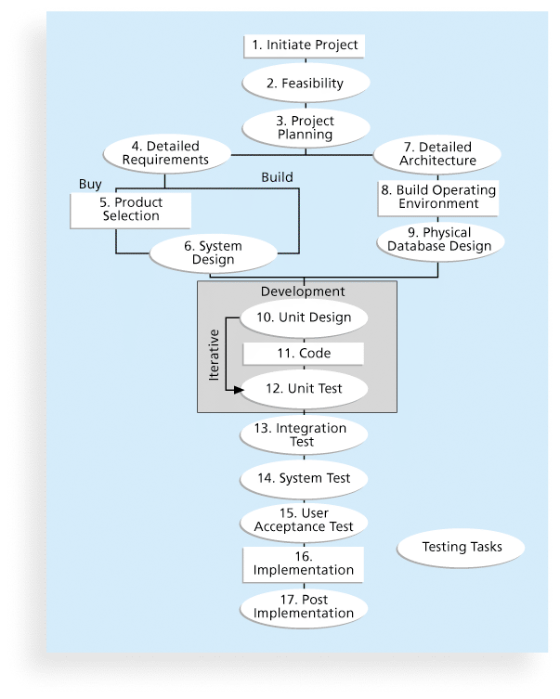
Figure 8-11. Testing Tasks in the Software Development Life Cycle

Slide 43
Types of Tests
Unit testing tests each individual component (often a program) to ensure it is as defect-free as possible
Integration testing occurs between unit and system testing to test functionally grouped components
System testing tests the entire system as one entity
User acceptance testing is an independent test performed by end users prior to accepting the delivered system

Slide 44
Modern Quality Management
Modern quality management:
Requires customer satisfaction
Prefers prevention to inspection
Recognizes management responsibility for quality

Slide 45
ISO Standards
ISO 9000 is a quality system standard that:
Is a three-part, continuous cycle of planning, controlling, and documenting quality in an organization
Provides minimum requirements needed for an organization to meet its quality certification standards
Helps organizations around the world reduce costs and improve customer satisfaction
See www.iso.org for more information

Slide 46
Global Issues
Many car manufacturers are proud to show and sell their electric cars (Audi, Cadillac, Chevrolet, etc.), but many people might wonder if these cars are safe
Fortunately, ISO has updated a standard on safety features in electric and hybrid cars to prevent electricity-related injuries
ISO 6469-3:2011, Electrically propelled road vehicles – protection of persons against electric shock, will help the global market for electric cars

Slide 47
Improving Information Technology Project Quality
Several suggestions for improving quality for IT projects include:
Establish leadership that promotes quality
Understand the cost of quality
Focus on organizational influences and workplace factors that affect quality
Follow maturity models

Slide 48
Leadership
As Joseph M. Juran said in 1945, “It is most important that top management be quality-minded. In the absence of sincere manifestation of interest at the top, little will happen below”*
A large percentage of quality problems are associated with management, not technical issues.
*American Society for Quality (ASQ), (www.asqc.org/about/history/juran.html).

Slide 49
The Cost of Quality
The cost of quality is the cost of conformance plus the cost of nonconformance
Conformance means delivering products that meet requirements and fitness for use
Cost of nonconformance means taking responsibility for failures or not meeting quality expectations
A study reported that software bugs cost the U.S. economy $59.6 billion each year and that one third of the bugs could be eliminated by an improved testing infrastructure

Slide 50
Five Cost Categories Related to Quality
Prevention cost: Cost of planning and executing a project so it is error-free or within an acceptable error range
Appraisal cost: Cost of evaluating processes and their outputs to ensure quality
Internal failure cost: Cost incurred to correct an identified defect before the customer receives the product
External failure cost: Cost that relates to all errors not detected and corrected before delivery to the customer
Measurement and test equipment costs: Capital cost of equipment used to perform prevention and appraisal activities

Slide 51
Chapter Summary
Project quality management ensures that the project will satisfy the needs for which it was undertaken
Main processes include:
Plan quality
Perform quality assurance
Perform quality control

